Slide 1
Schedulefy
By Zhoel zhelev

Slide 2
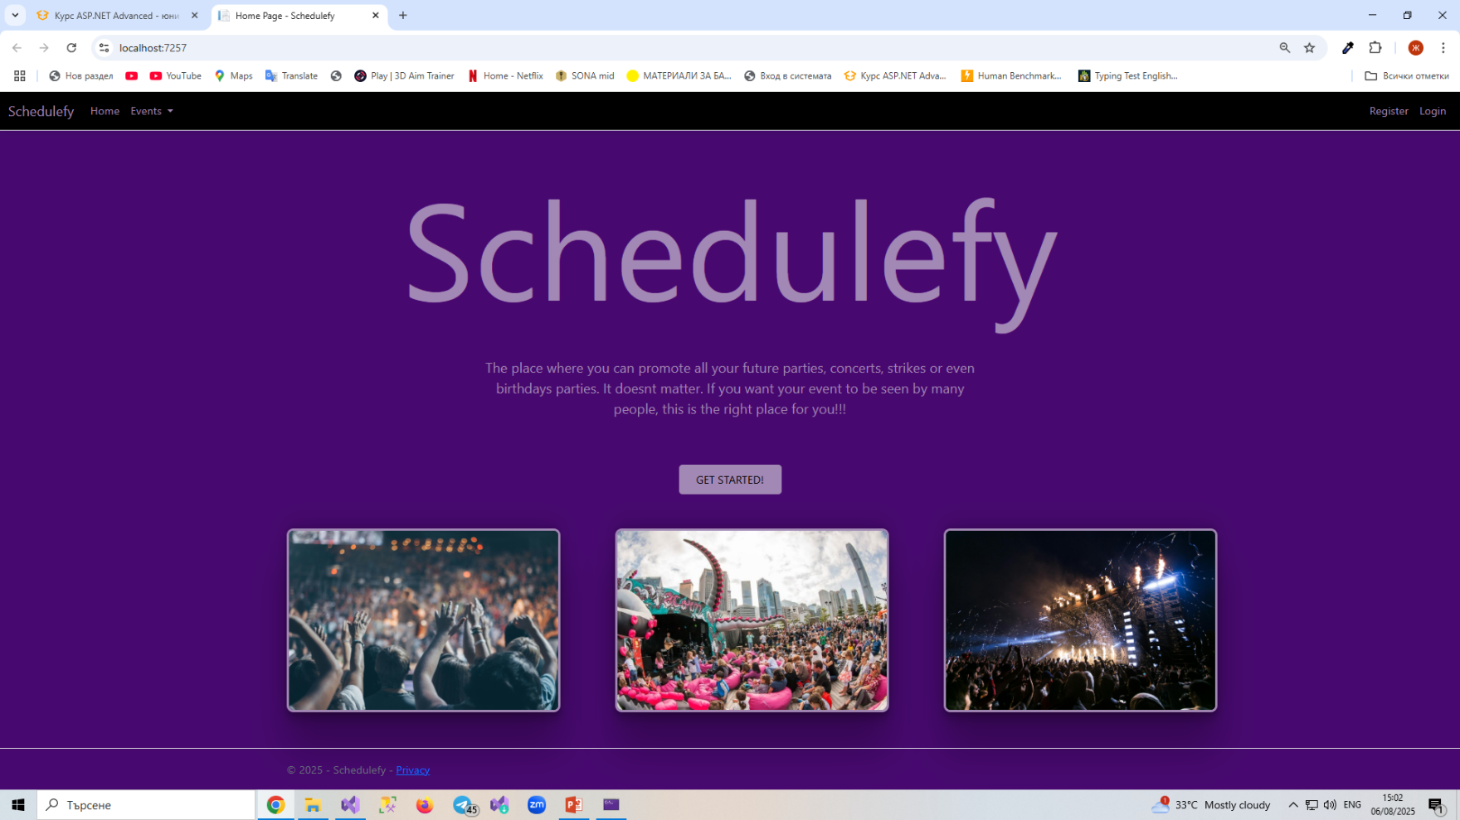
If you are not logged in, yet. There is Get Started button.
HOME PAGE – logged out

Slide 3
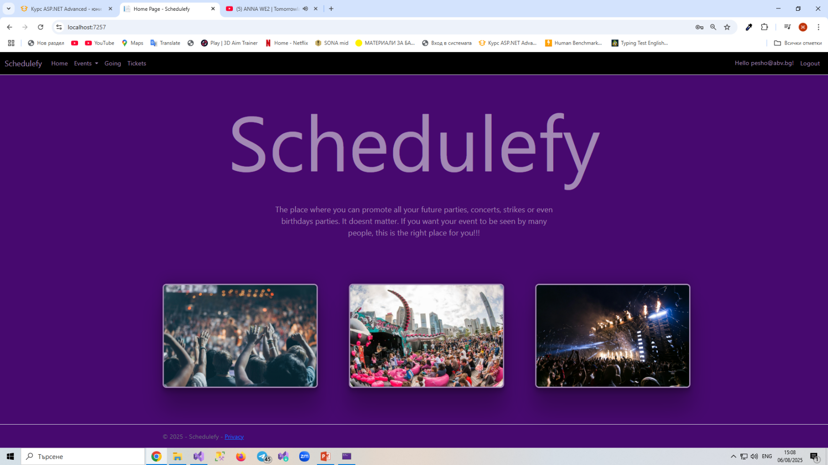
If you are logged in, Get Started Button disappear.
HOME PAGE – logged in

Slide 4
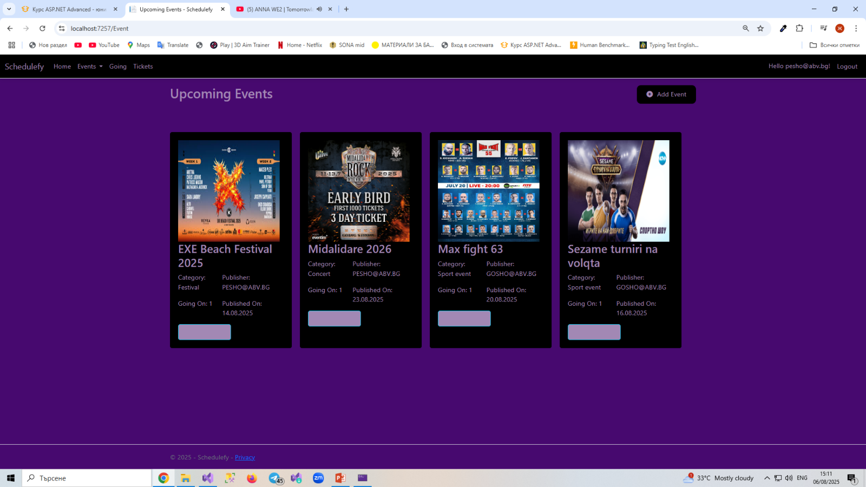
That’s the main page with all of Upcoming Events added by users. That page can also be seen by not logged in users. There is Add Event Button in the right corner. If you are not logged in, you can not see the Add Event button.
UPCOMING EVENTS – logged in

Slide 5
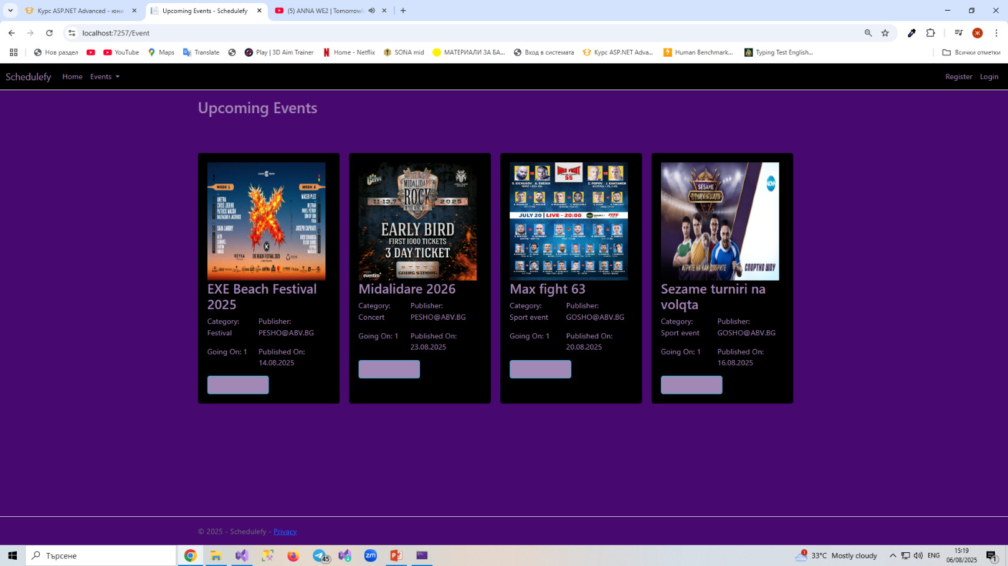
That’s how Upcoming Events page look when you are not logged in. You can not see the Add Event button in the right corner.
UPCOMING EVENTS – logged out

Slide 6
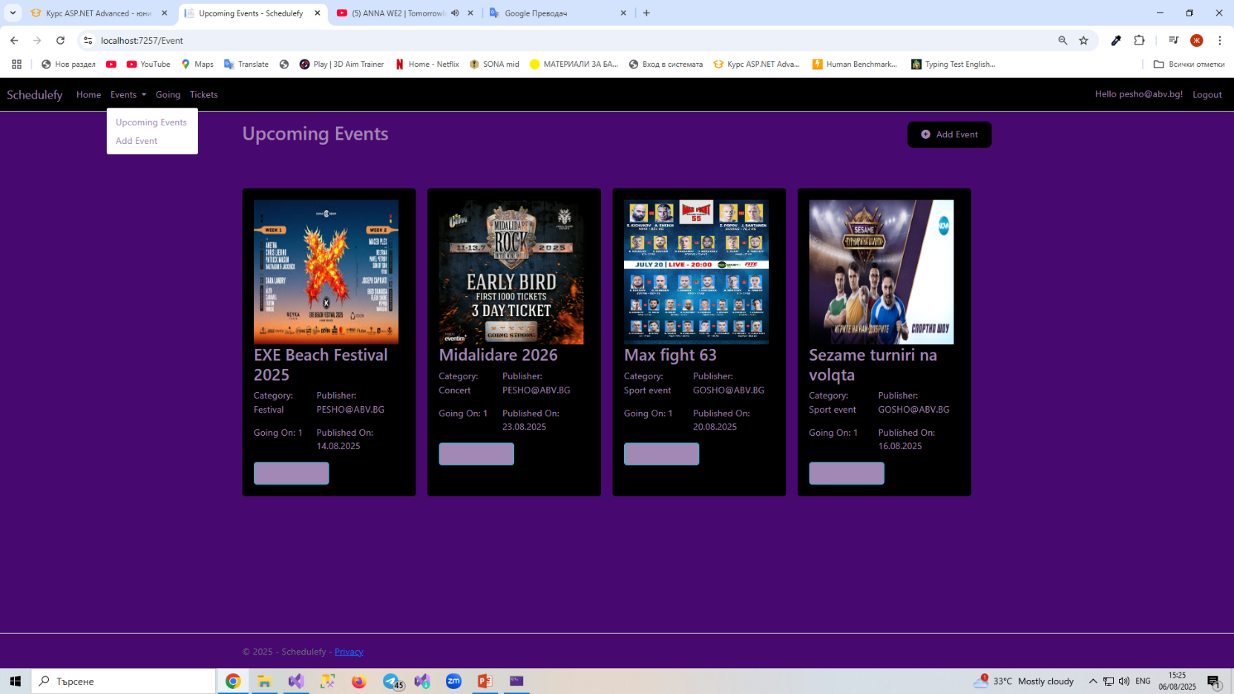
You can add event by the Add Event button in the right corner or by clicking on events in the nav bar and then clicking add event. It doesn’t matter which way you chose.

Slide 7
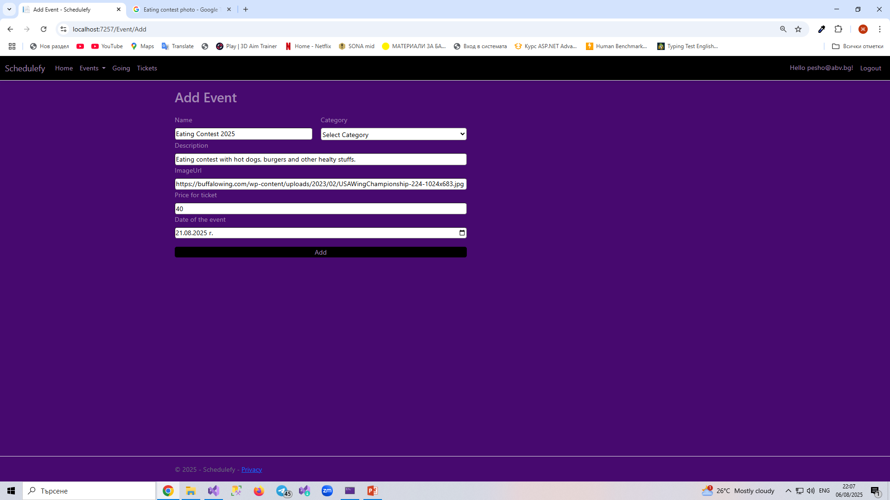
After clicking on some of the Add Event buttons you will be redirect to this page. You have too fill this form. If you miss to fill any line(except ImageUrl) or fill it with invalid input, it will not happened anything.

Slide 8
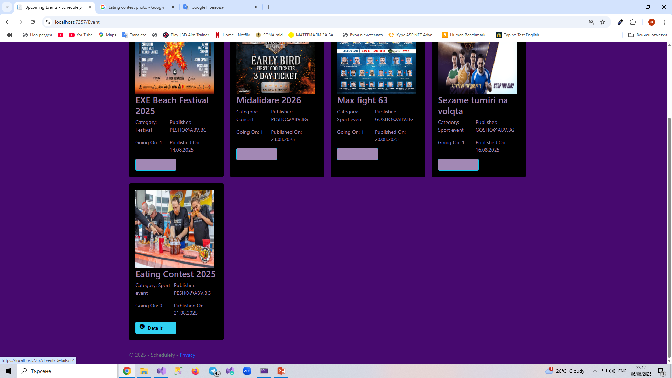
If you fill successfully form in the add event page, the event will be added in the upcoming events page. Every event has a Details button below it. After clicking it you are redirect to page with full description of the event.

Slide 9
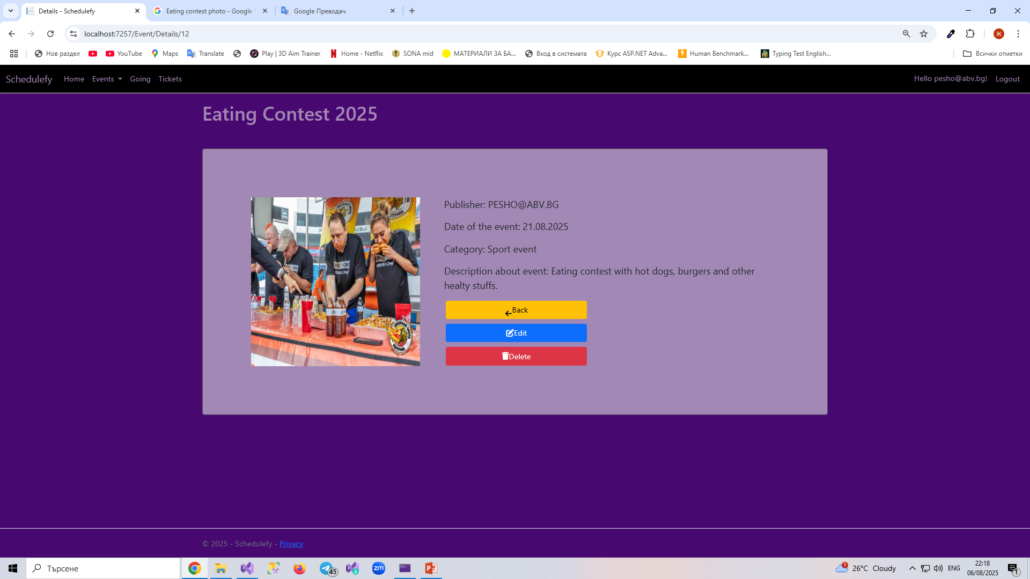
Detail page has a full information for the event. If you are creator of the event, you have back, edit and delete buttons.

Slide 10
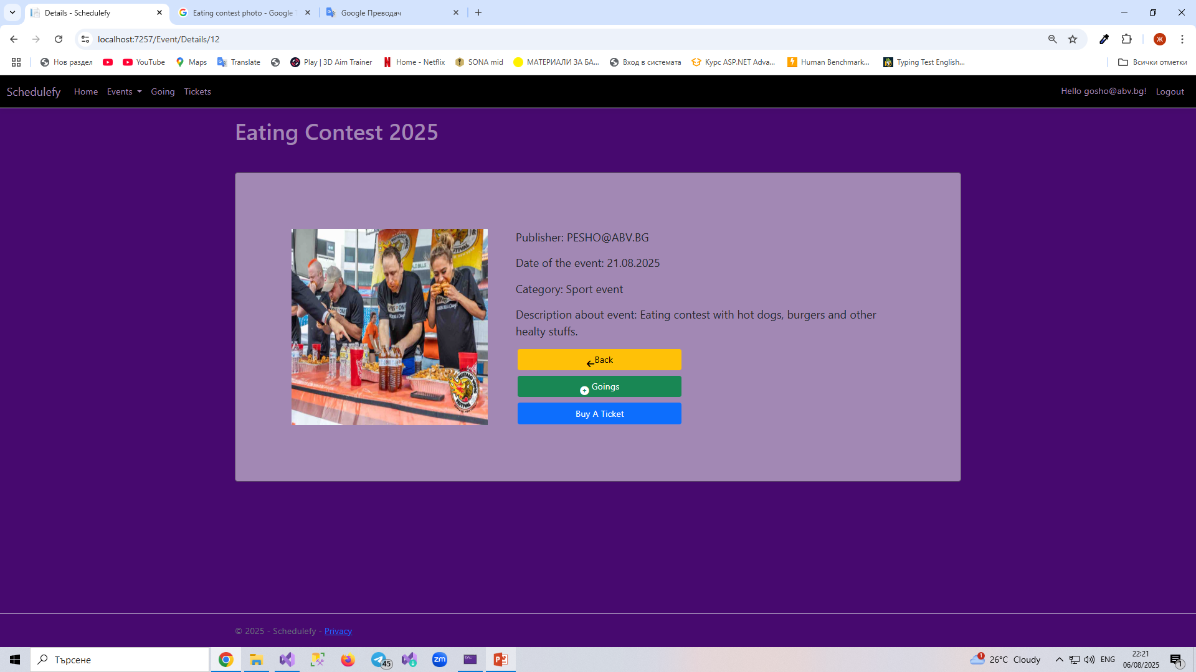
If you are not creator of the event, you have back, going and buy a ticket button.

Slide 11
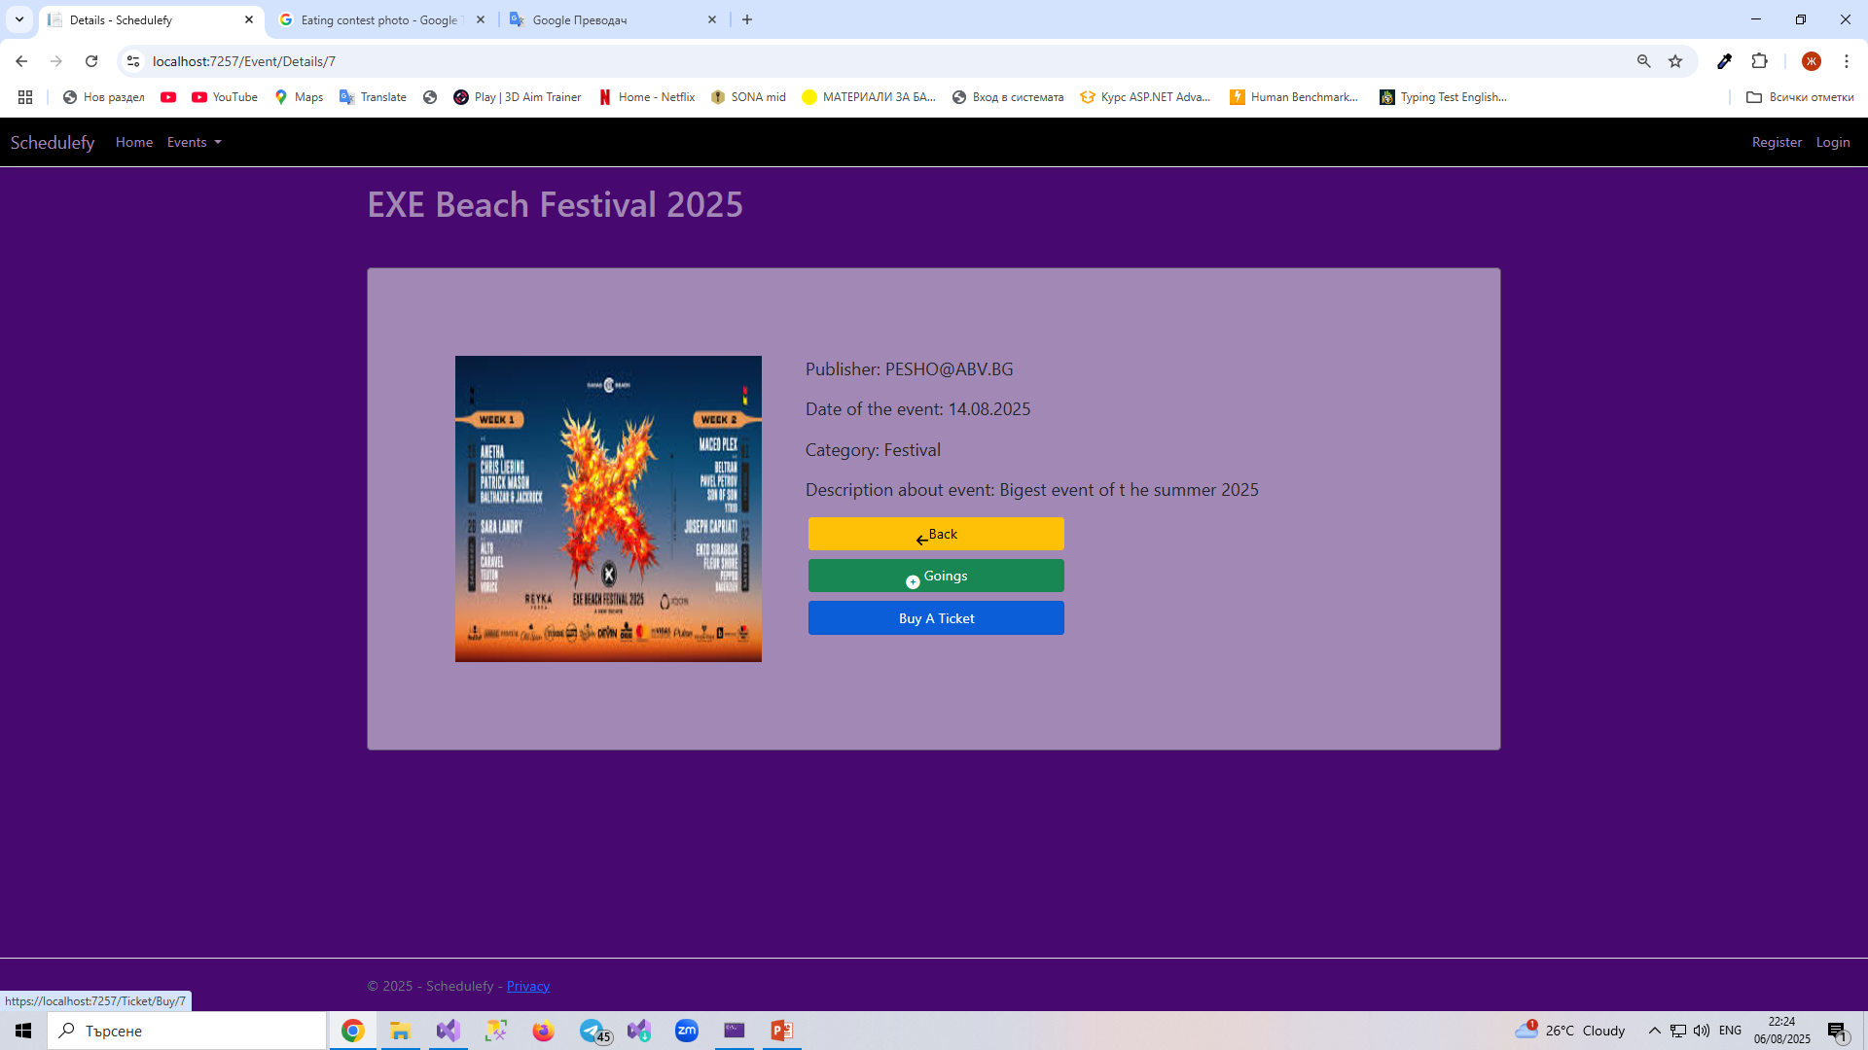
If you are logged out user, you still have back, goings and buy a ticket button for every event. But if you click goings or buy a ticket button, you will be redirect to log in page and you have to be logged in to use them. Back button works without to be logged in.

Slide 12
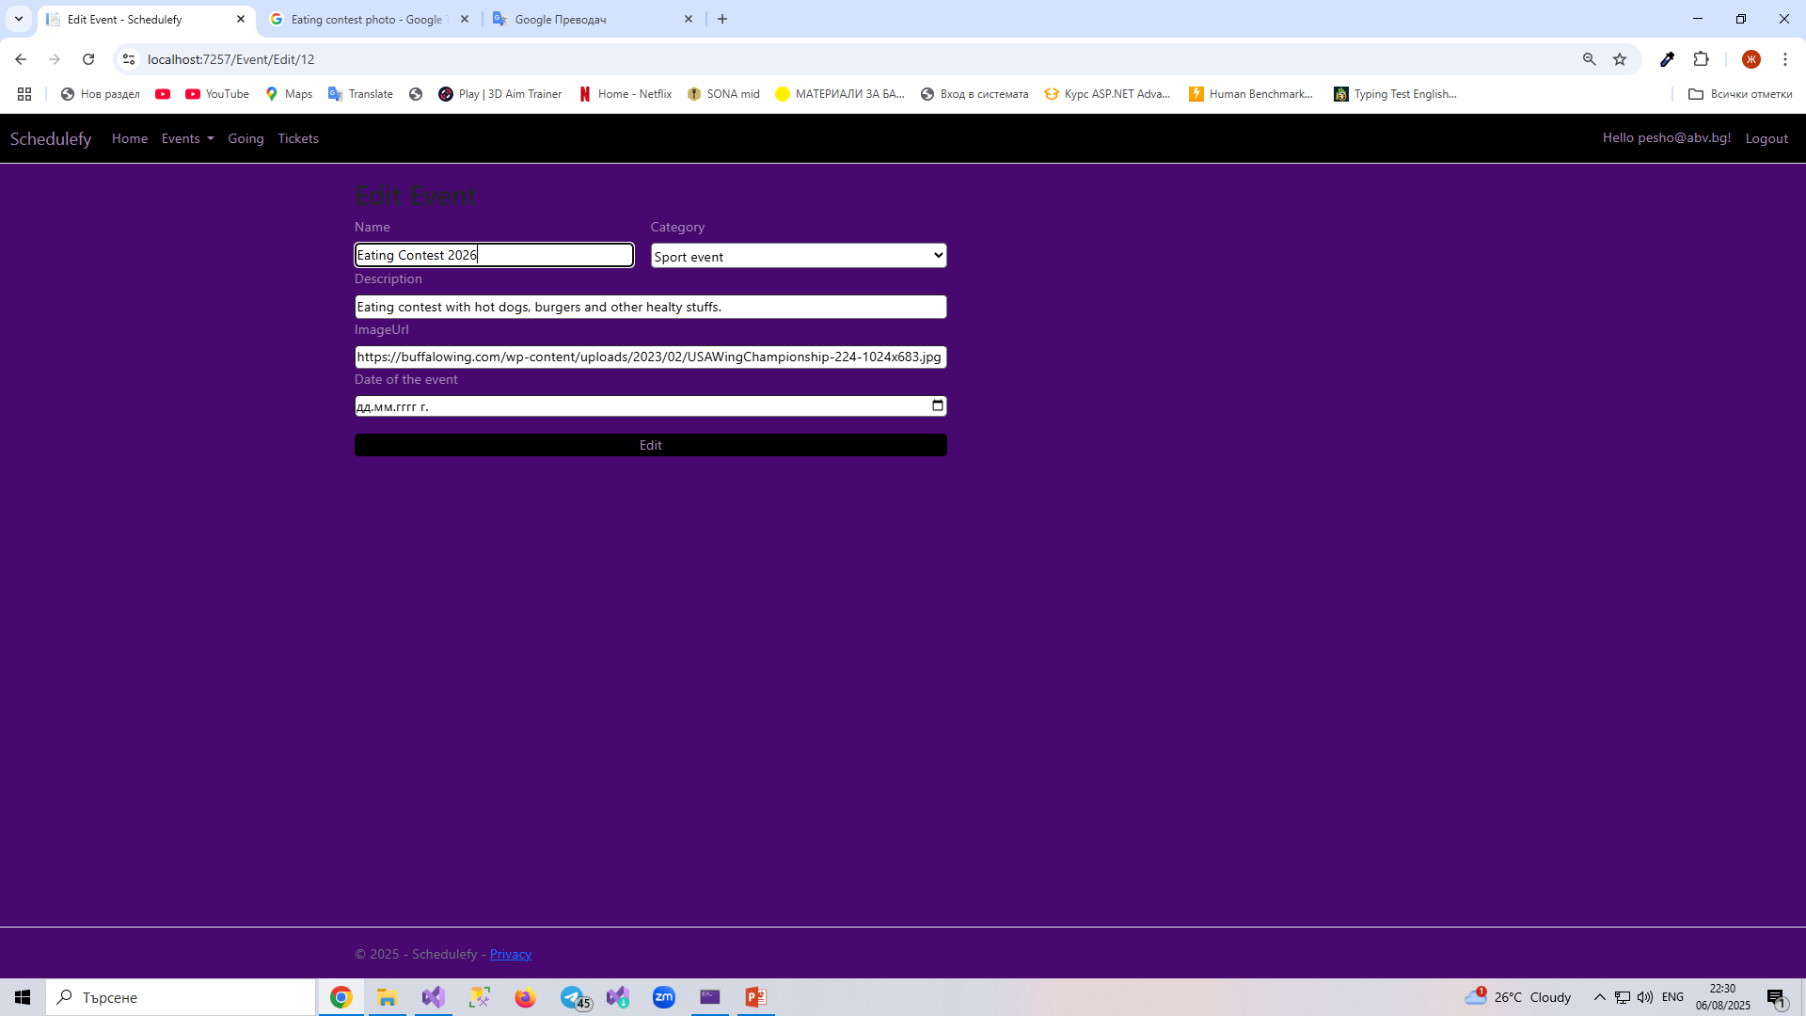
If you are creator of the event and click edit button you go to edit event page. If you fill the form with invalid input or not filling everything, it will not happened anything. Same as Add Event page.

Slide 13
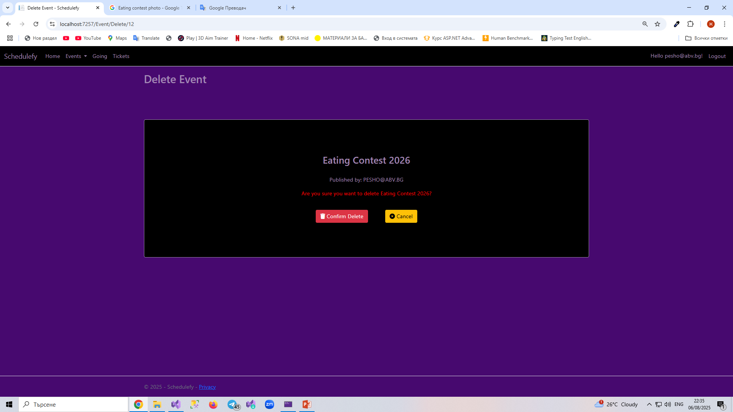
If you are creator of the event and click delete button you are redirect to this page. If you click cancel you will not delete the event. If you click confirm delete, event will be deleted and will not be shown up in upcoming events.

Slide 14
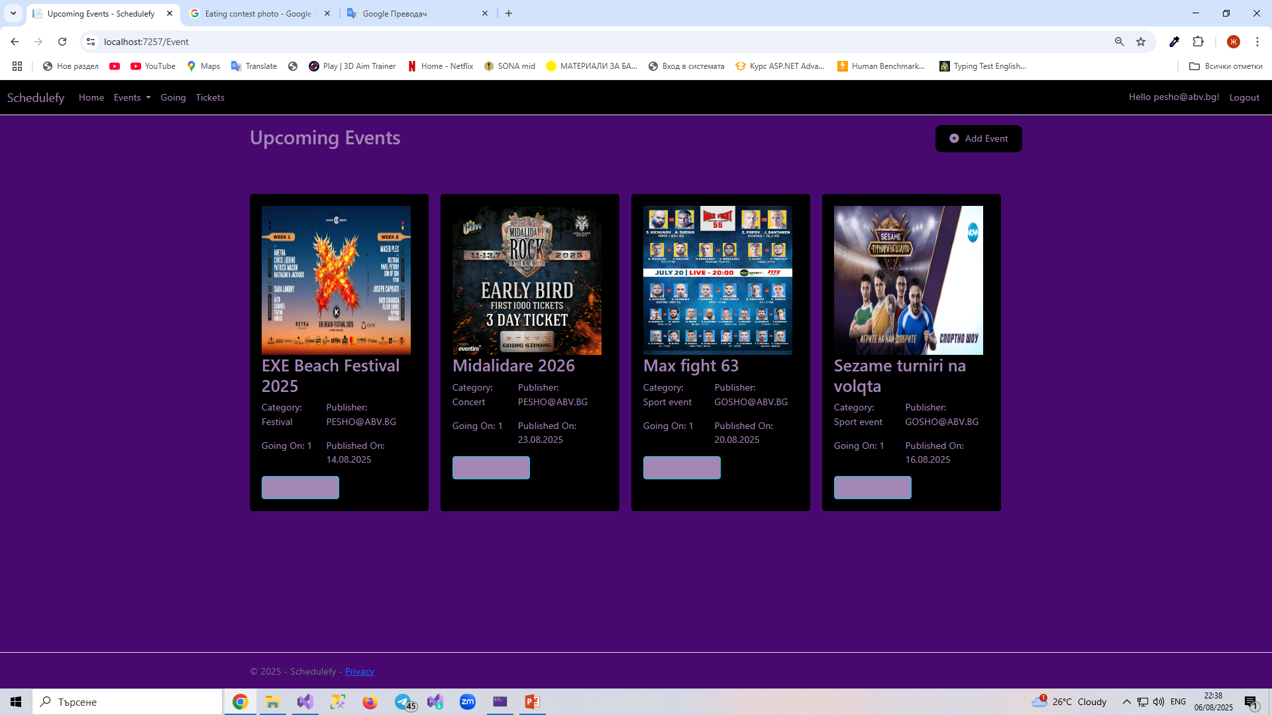
As you can see event is deleted, but of course you can create it again.

Slide 15
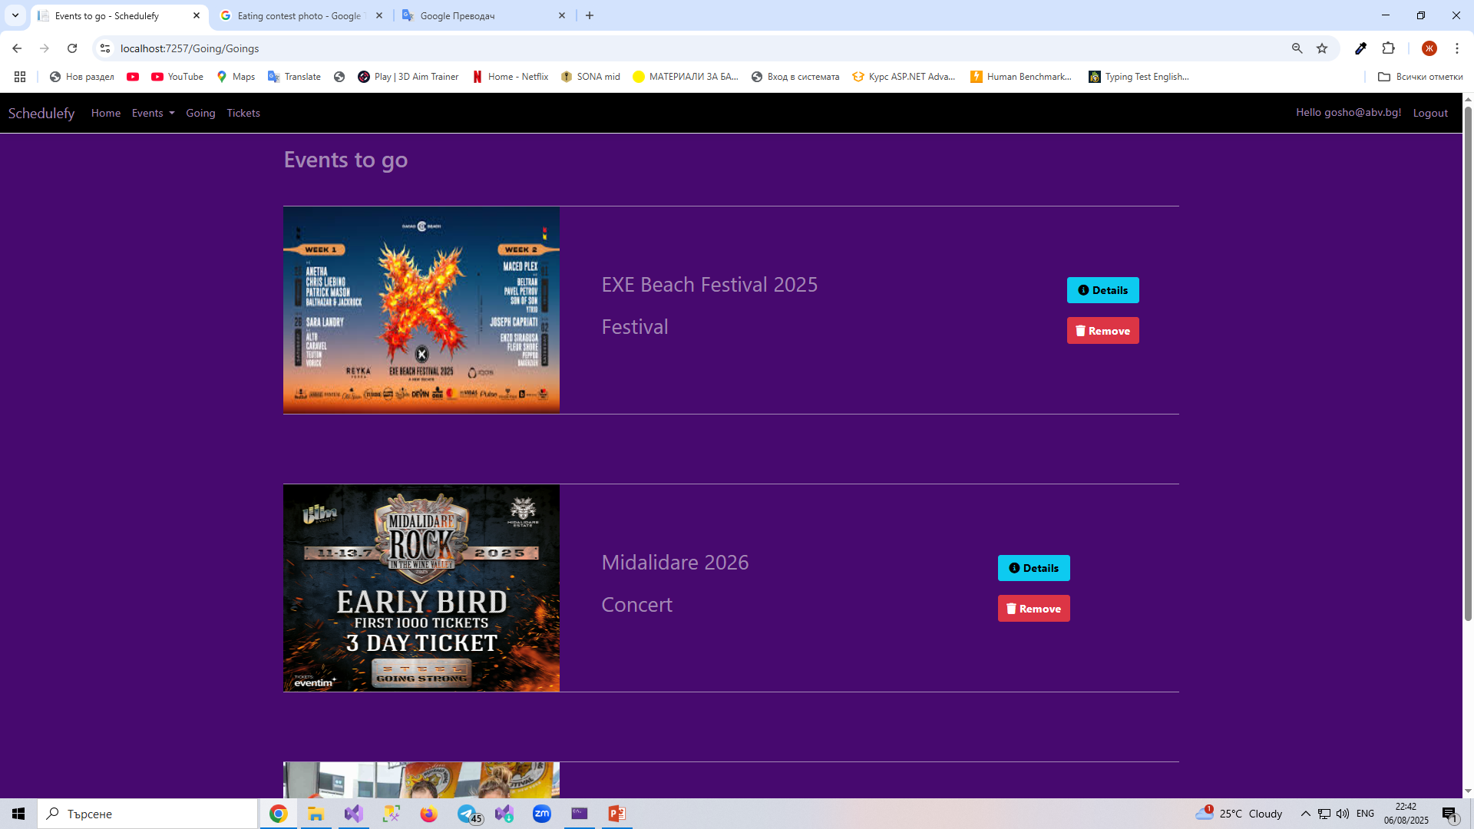
If you are not creator of the event and click on going button, event will be added to the events you want visit. You can go to this page and by clicking on going button up in the nav bar. Every event has two buttons: Details and Remove. If you click details button, you will be redirect to the Detail page of the event.

Slide 16
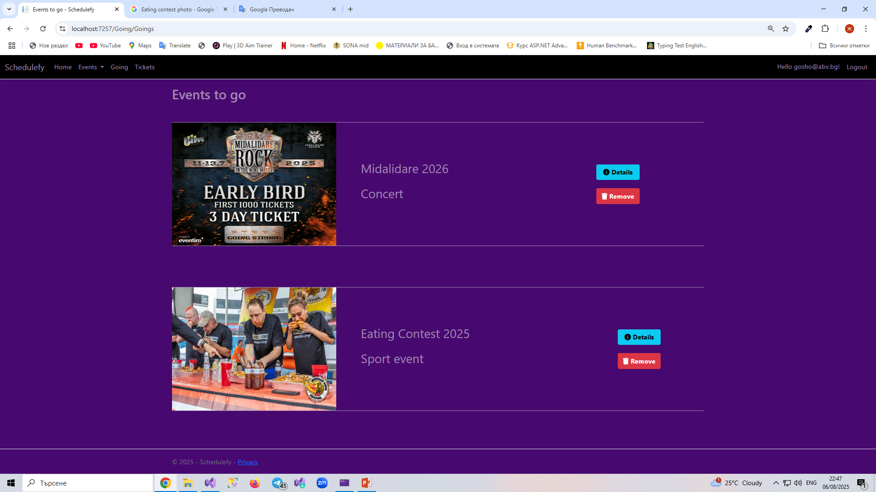
If you click Remove button as you can see the event is removed from goings. Of course you can add it again. Once added event can not be added again until its removed.

Slide 17
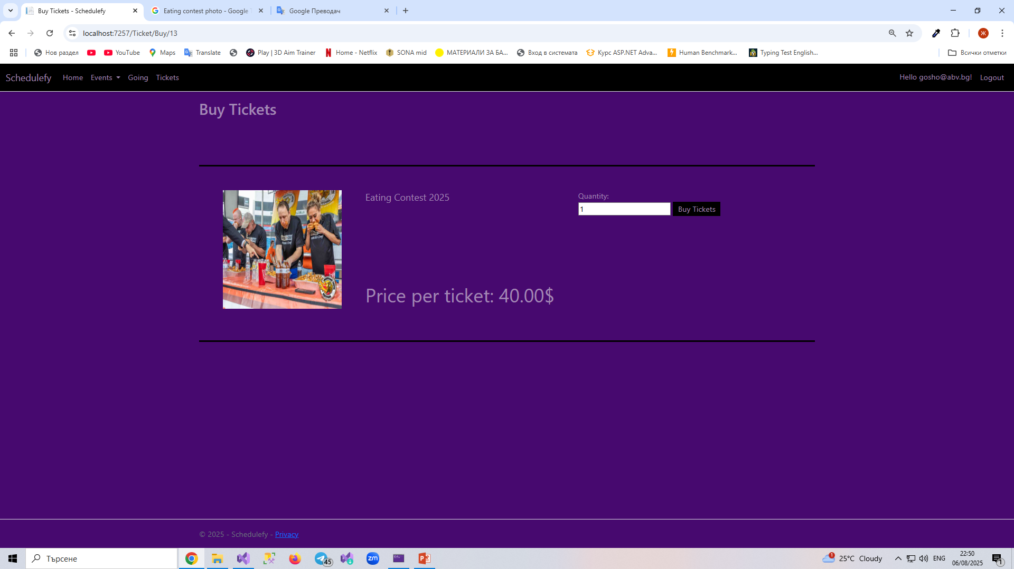
When you click Buy A Ticket button you are redirect to this page. It shows the price of a ticket. You have to chosee the quantity of tickets you want to buy. By clicking Buy Tickets you confirm to buy the amount of tickets you chose.

Slide 18
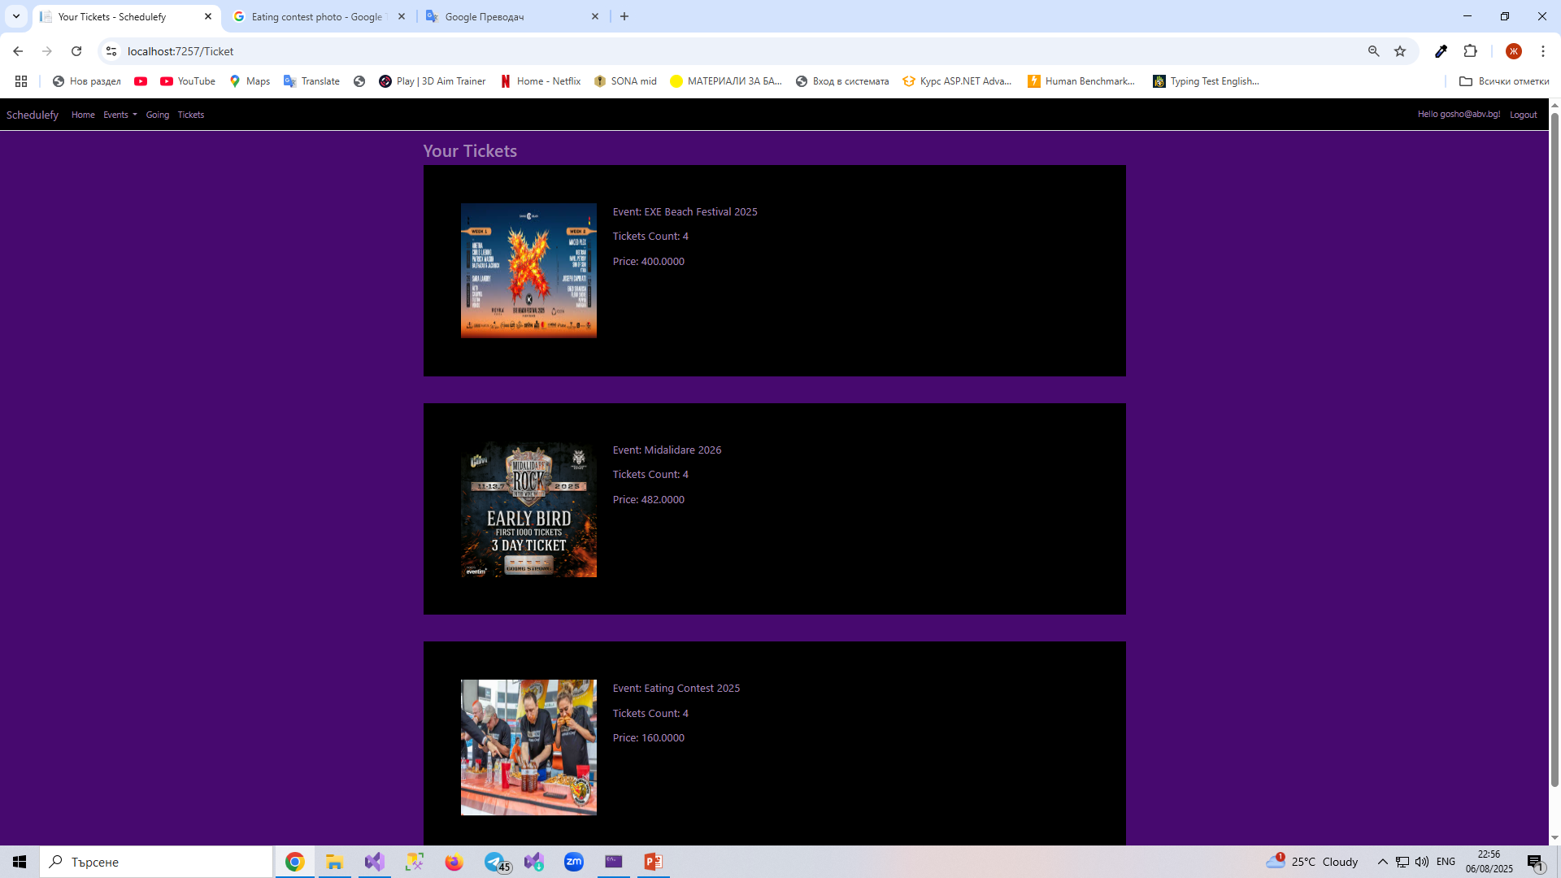
If you confirm buying the tickets you are redirected to the page where you can see all of your tickets. On every ticket there is name and image of the event, total count of that ticket. You can go to tickets page by clicking Tickets button up in the nav bar.

Slide 19
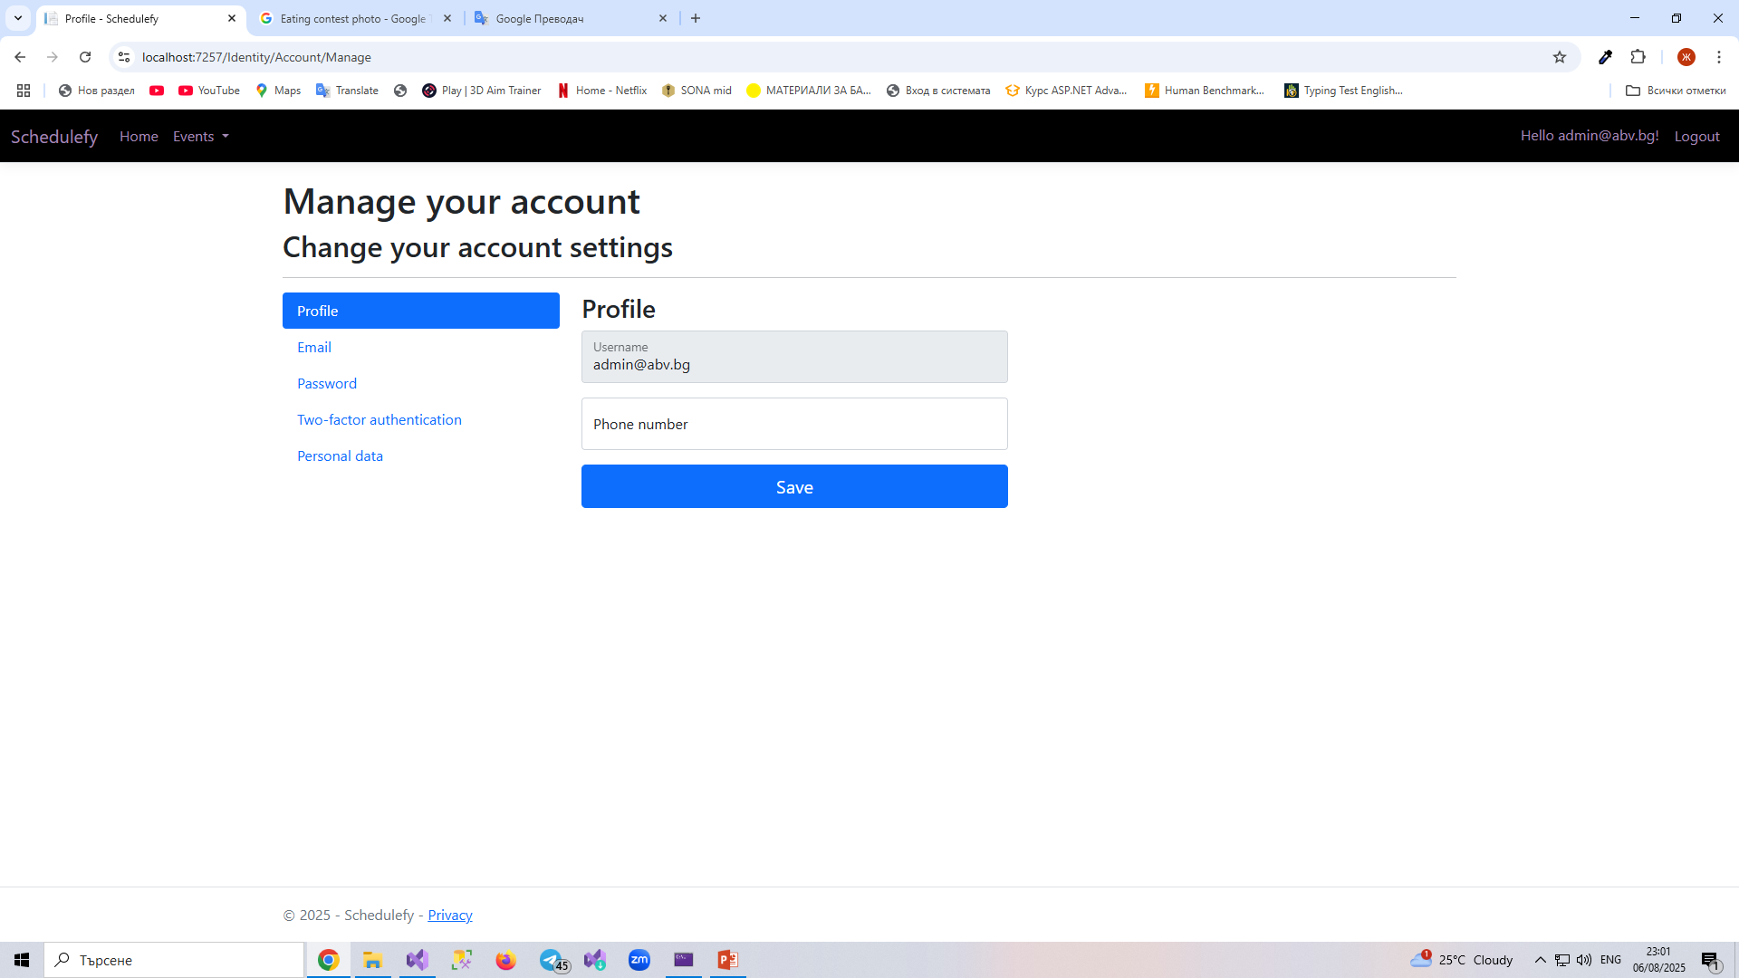
There is some users that are admins. They don’t have Going page and Ticket page.

Slide 20
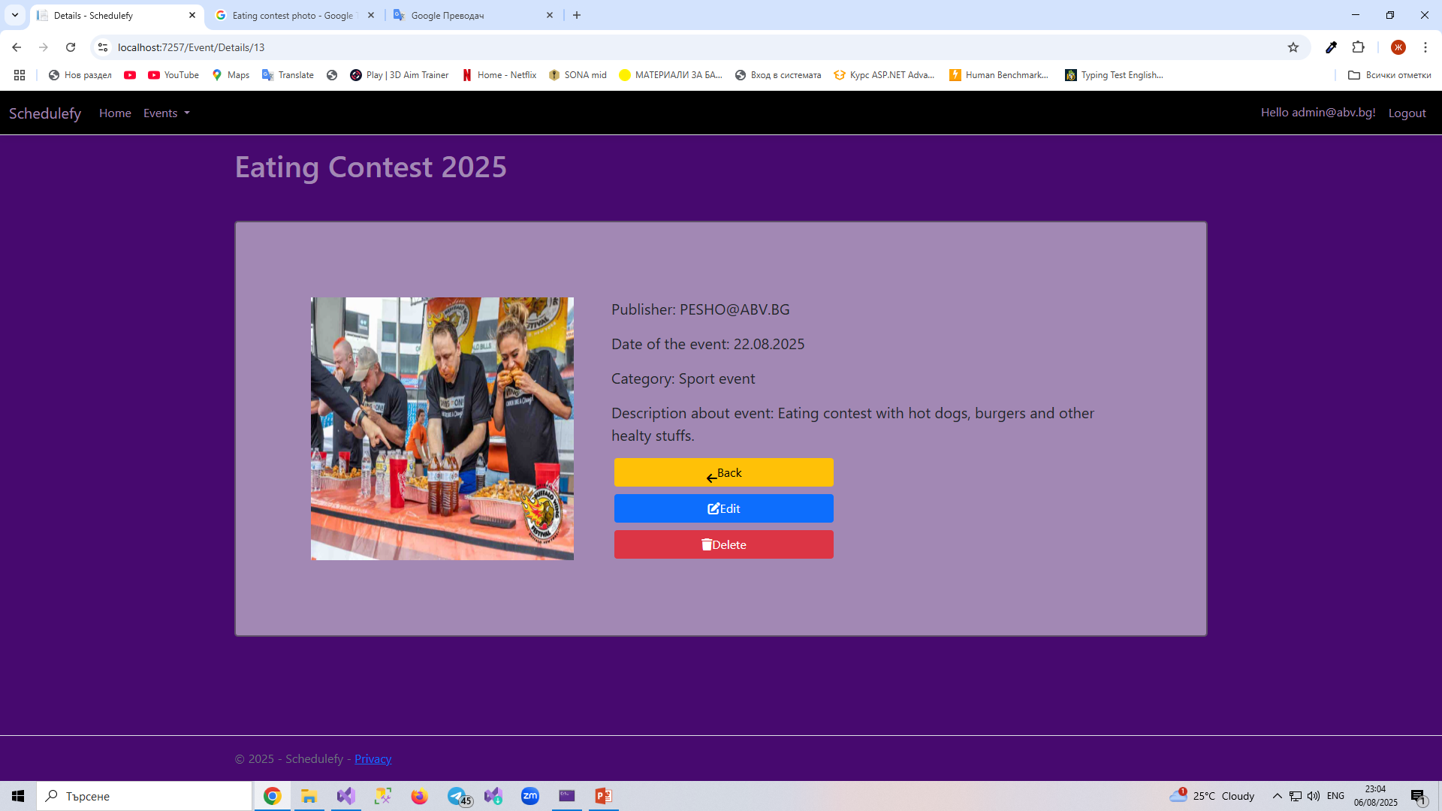
Admin users can Add event, Edit events and Delete events. It doesn’t matter who created the event. Admin users can delete it or edit it.

Slide 21
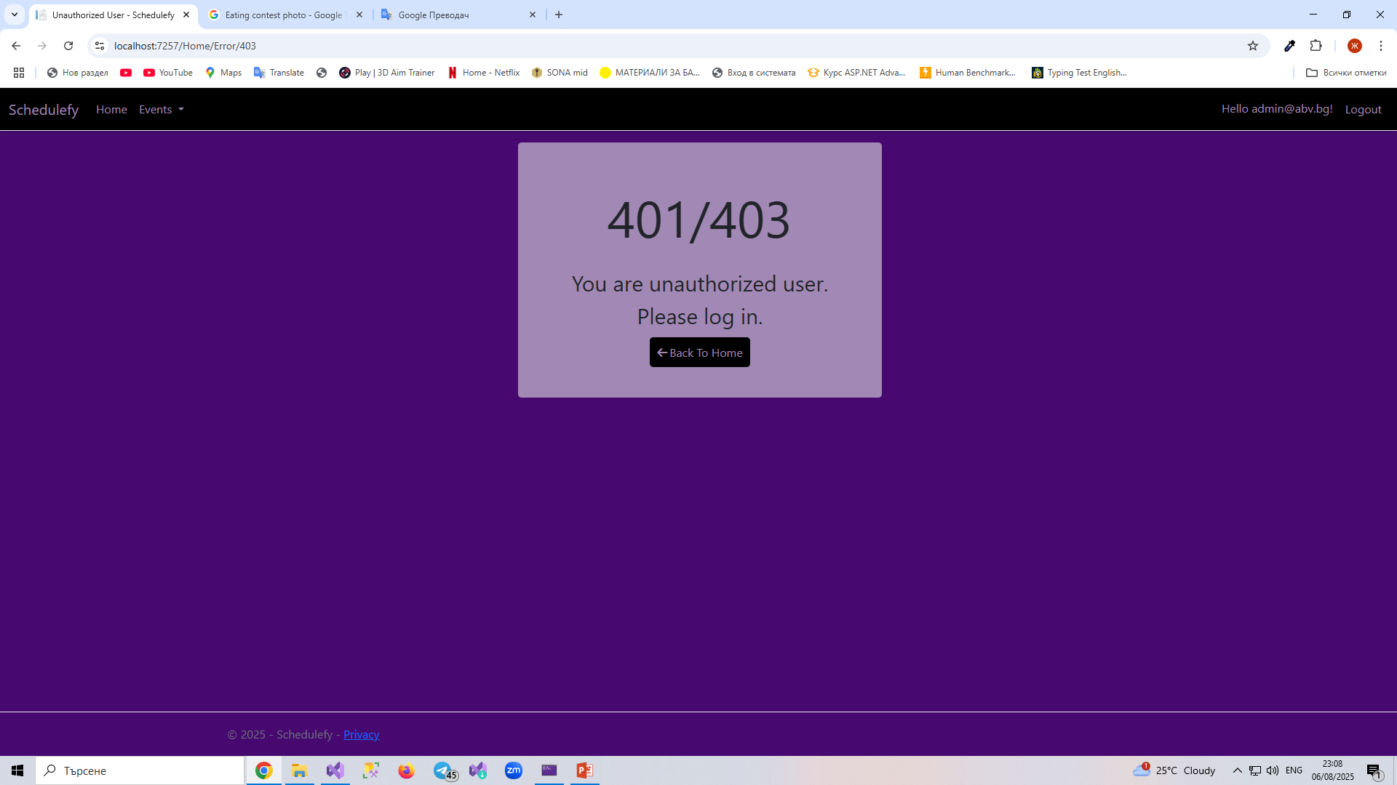
My web site also has custom error page for unauthorized users.

Slide 22
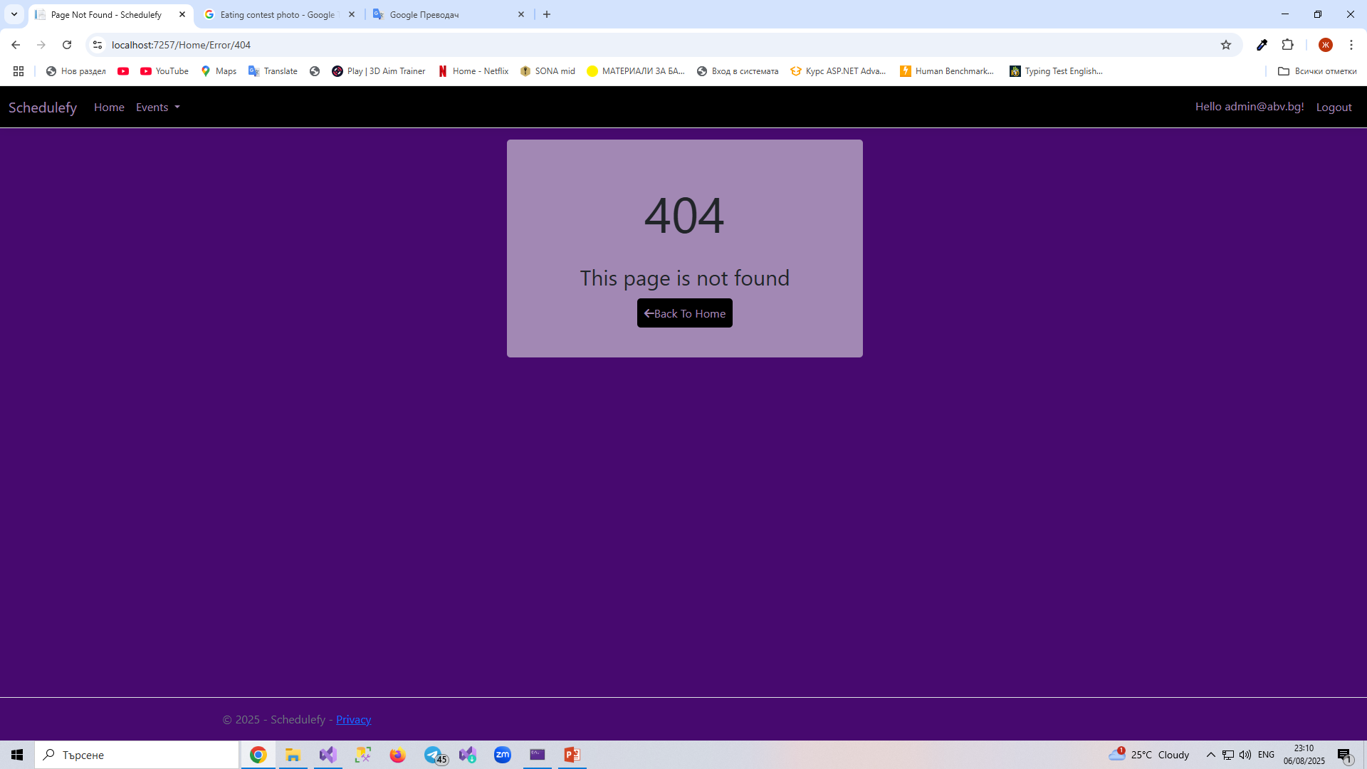
It also has error page for pages that are not found.

Slide 23
THANKS FOR WATCHING!
That’s almost everything for my website. I have tried to cover everything. ☺

